Slide 1



Amazon Global Superstore
View in Power BI
Last data refresh:
5/2/2024 11:33:01 PM UTC
Downloaded at:
5/3/2024 2:27:19 PM UTC

Slide 2
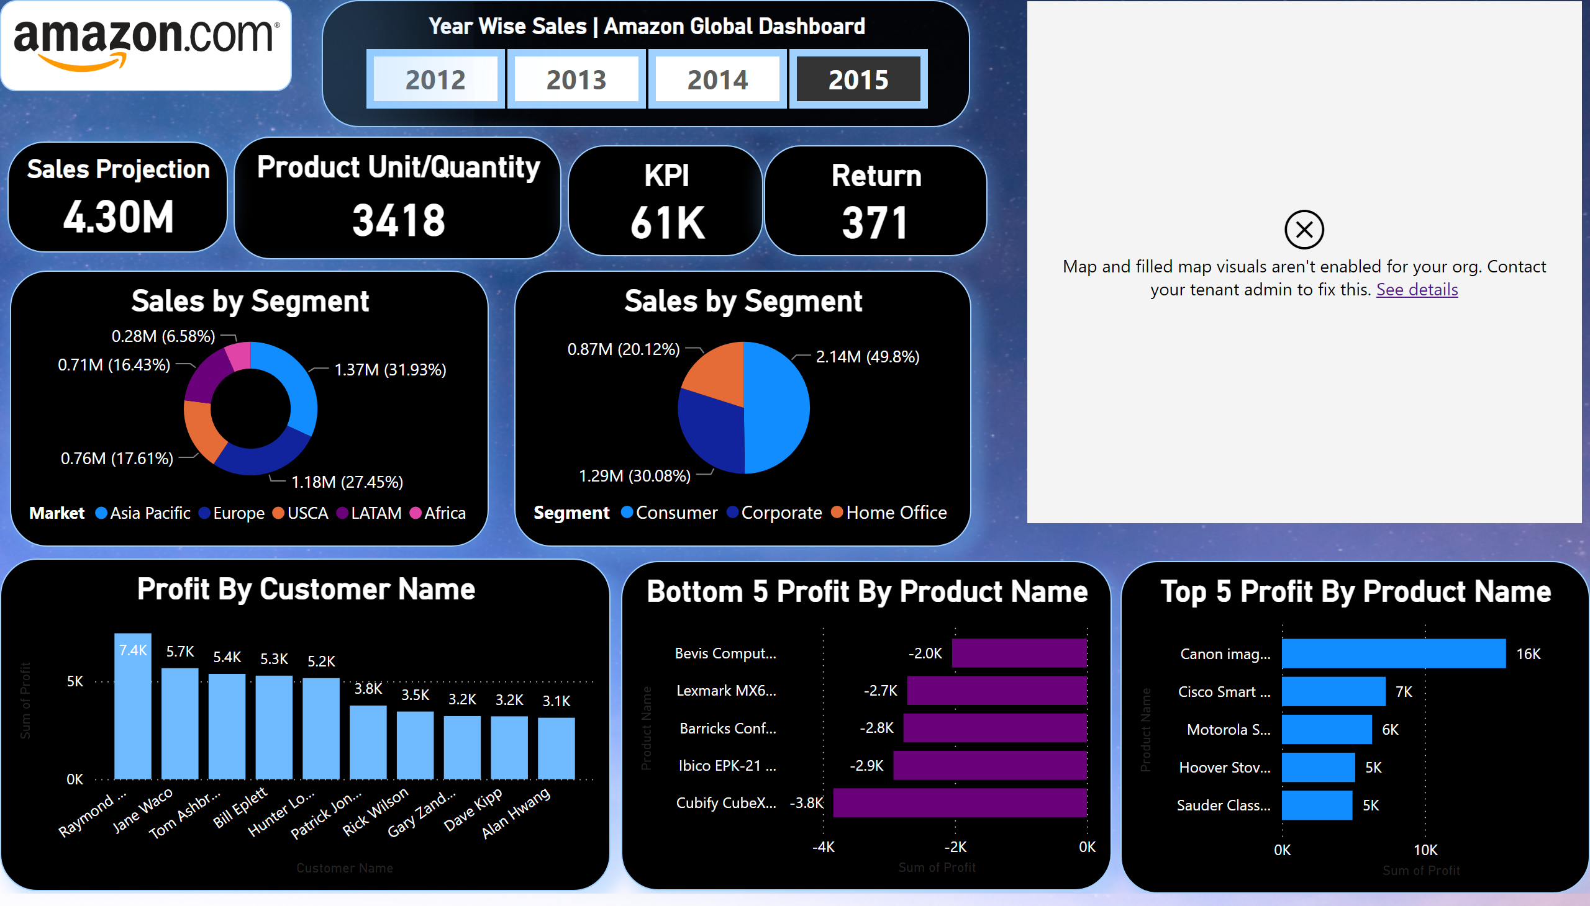
Report 1

